Slide 1
A Revolution of Mind
Greg Burnham November 22, 2013

Slide 2
Sabotage at the bay of pigs
Greg Burnham
November 22, 2013

Slide 3
Myths
PRESIDENT KENNEDY:
cancelled the promised pre-dawn air strikes
promised direct US Military intervention if needed in the form of US Navy jet air cover
THE ANTI-CASTRO CUBANS:
expected direct US intervention by the armed forces
harbored hatred toward JFK for failing to provide it

Slide 4
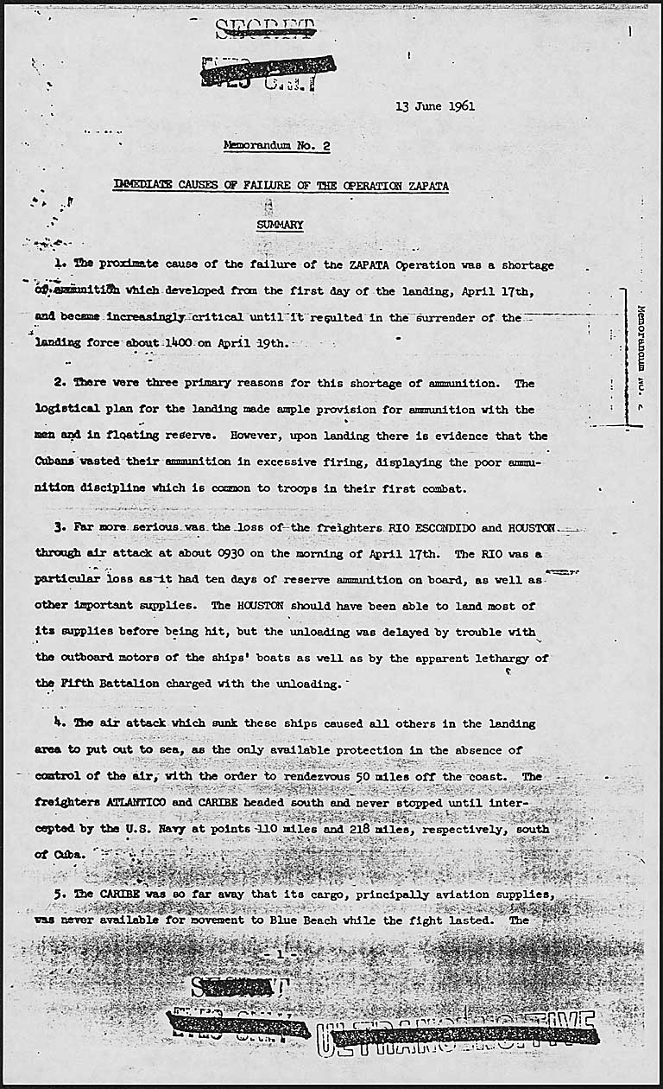
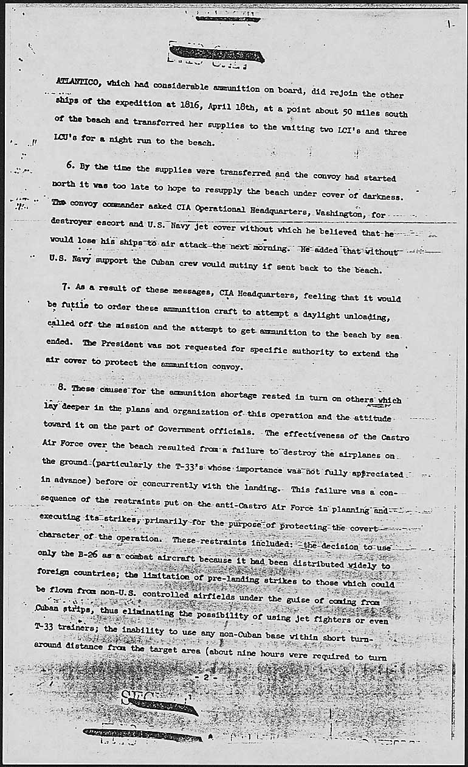
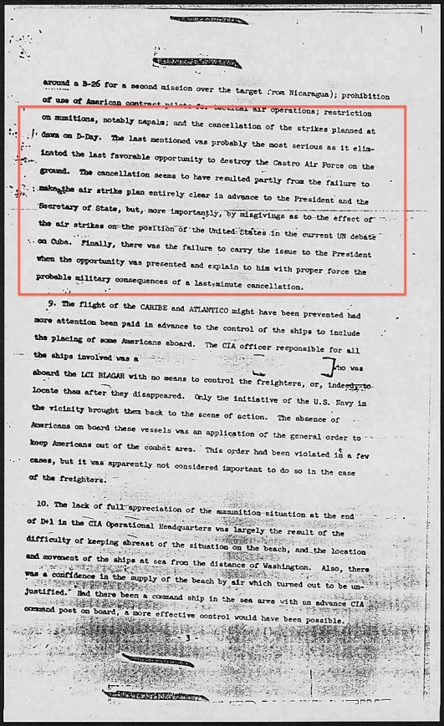
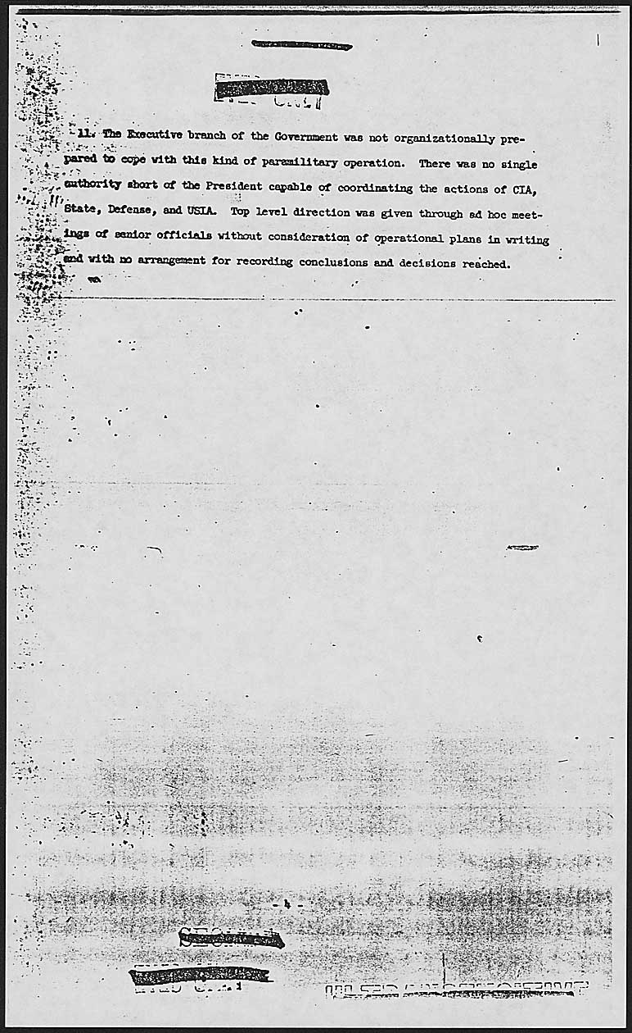
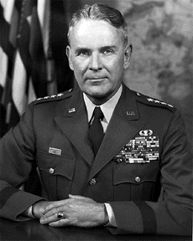
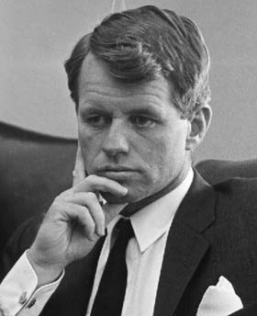
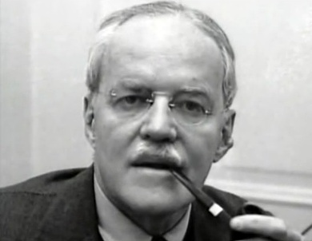
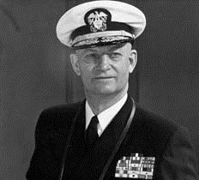
CUBAN STUDY GROUP
Maxwell Taylor
Robert Kennedy
Allen Dulles
Arleigh Burke

Slide 5
Did the president cancel the D-Day airstrikes? No.
FOREIGN RELATIONS OF THE UNITED STATES, 1961–1963 VOLUME X, CUBA, 1961-1962, DEPARTMENT OF STATE:
43. “At about 9:30 PM on 16 April, Mr. McGeorge Bundy, Special Assistant to the President, telephoned General C. P. Cabell of CIA to inform him that dawn airstrikes the following morning should not be launched until they could be conducted from a strip within the beachhead. Mr. Bundy indicated that any further consultation with regard to this matter should be with the Secretary of State.”

Slide 6
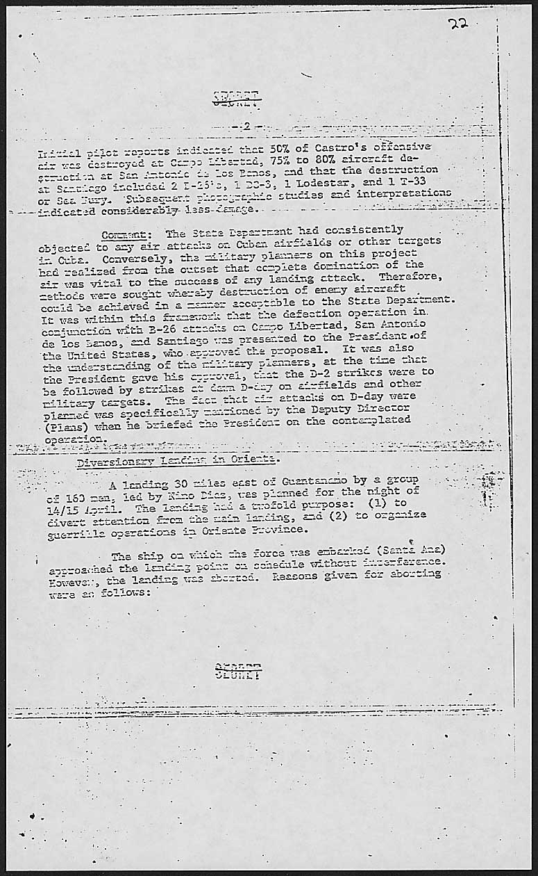

Slide 7
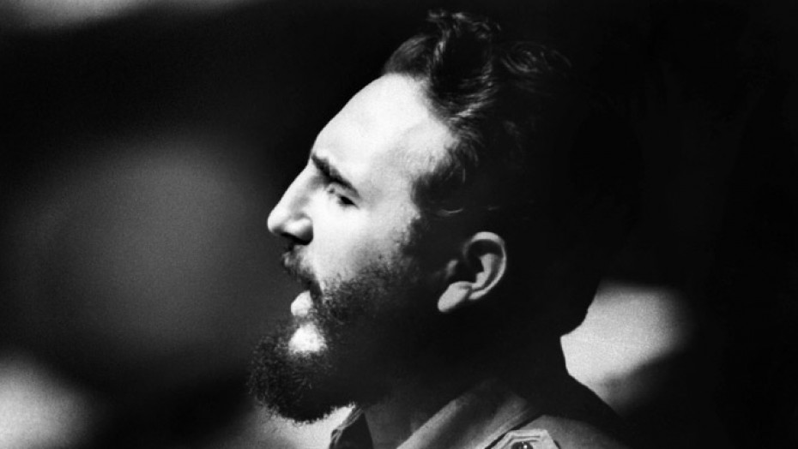
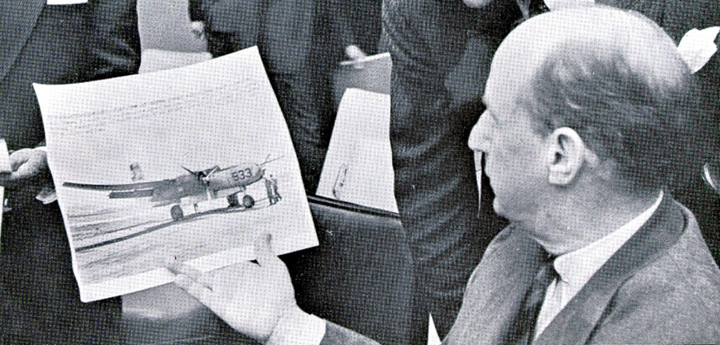
Castro
Stevenson

Slide 8
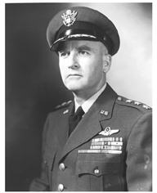
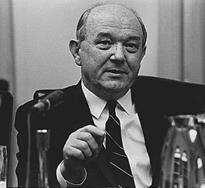
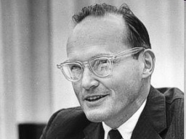
Stevenson
Castro
Rusk
Cabell
McBundy

Slide 9
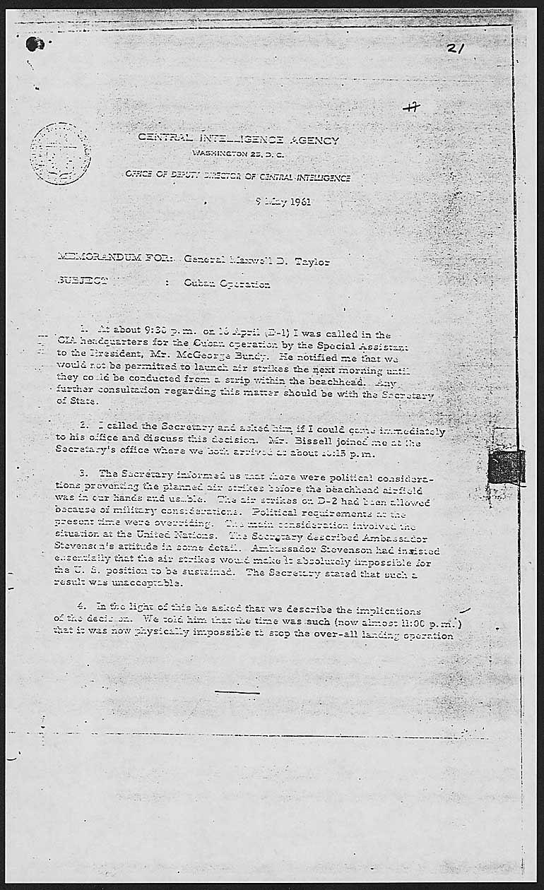
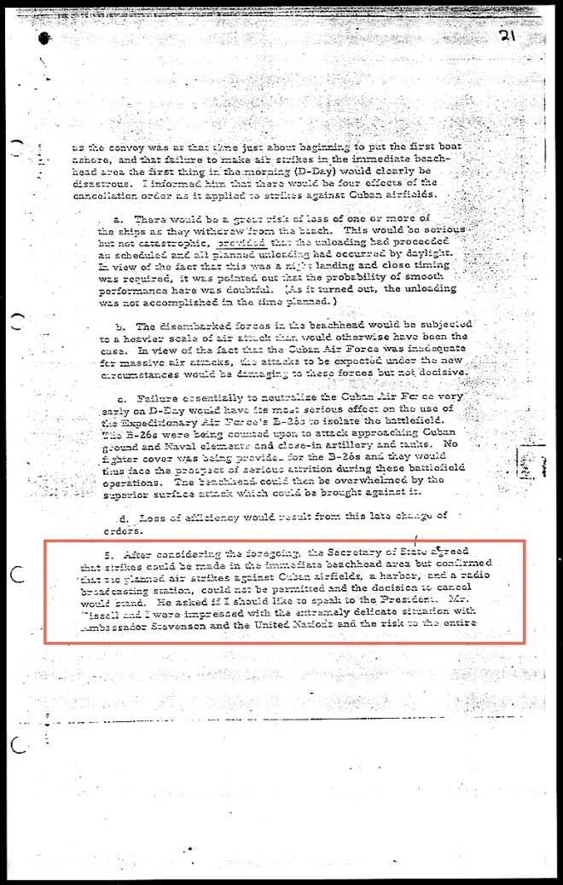
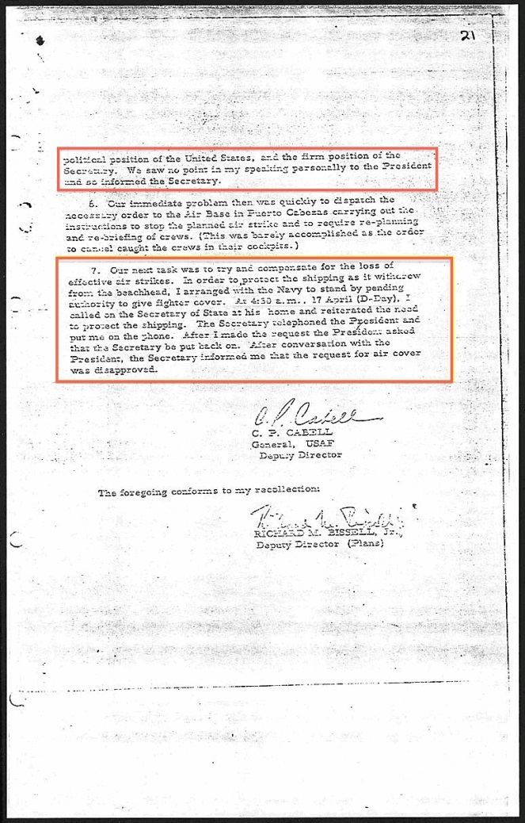
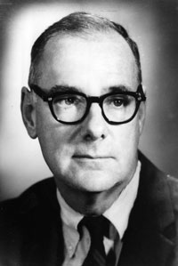
Cabell
Bissell
Rusk

Slide 10
Cabell
Bissell
Rusk

Slide 11
Was the President made aware that cancellation of the airstrikes was being considered? No.
FOREIGN RELATIONS OF THE UNITED STATES, 1961–1963 VOLUME X, CUBA, JANUARY 1961–SEPTEMBER 1962, DOCUMENT 231:
44. “The Secretary of State indicated subsequently that their [Cabell and Bissell’s] presentation led him to feel that while the air strikes were indeed important, they were not vital. However, he offered them the privilege of telephoning the President in order to present their views to him. They saw no point in speaking personally to the President and so informed the Secretary of State.”

Slide 12
Could the president have ordered, while bound by the prohibitions of NSC 5412 /2, US Navy jets to provide air cover? No.
MEMORANDUM NO. 1 FROM THE CUBA STUDY GROUP TO PRESIDENT KENNEDY:
19. “From its inception the plan had been developed under the ground rule that it must retain a covert character, that is, it should include no action which, if revealed, could not be plausibly denied by the United States and should look to the world as an operation exclusively conducted by Cubans. This ground rule meant, among other things, that no U.S. military forces or individuals could take part in combat operations.”

Slide 13
DID KENNEDY:
promise direct US Military intervention if necessary in the form of jet air cover?
break that promise?

Slide 14
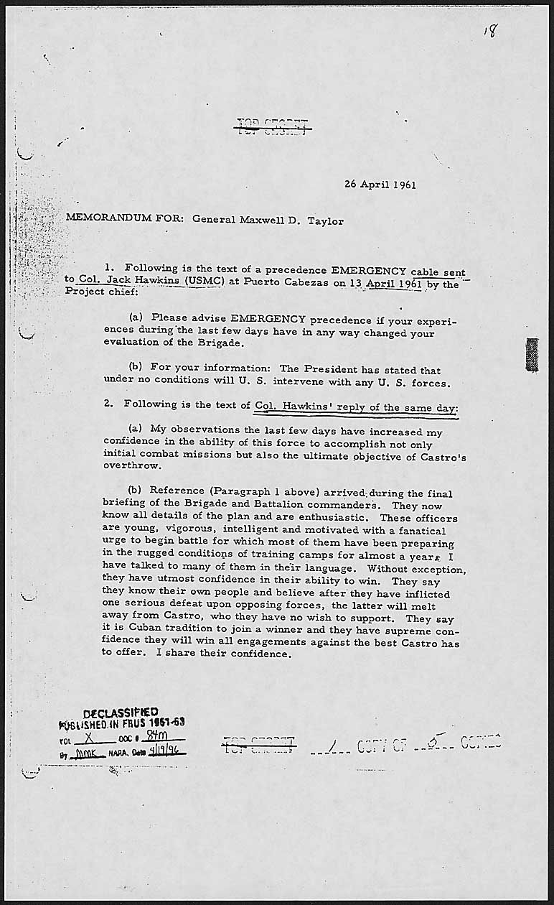
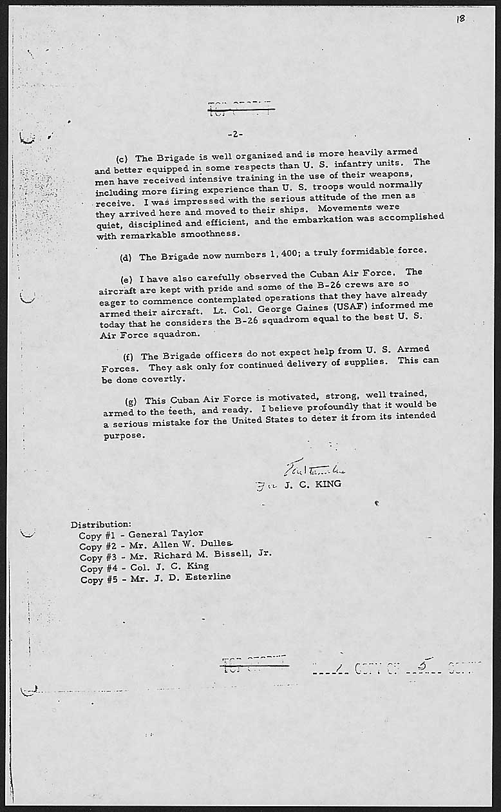

Slide 15
DID THE ANTI-CASTRO CUBANS:
expect direct intervention by the armed forces of the United States?
harbor hatred toward JFK for breaking that promise?

Slide 17
FIVE DAYS BEFORE D-DAY, AT A PRESS CONFERENCE ON APRIL 12, PRESIDENT KENNEDY WAS ASKED:
“How far would the U.S. go to help an uprising against Castro?”
PRESIDENT KENNEDY:
"First, I want to say that there will not be, under any conditions, an intervention in Cuba by the United States Armed Forces. This government will do everything it possibly can… I think it can meet its responsibilities, to make sure that there are no Americans involved in any actions inside Cuba. The basic issue in Cuba is not one between the United States and Cuba. It is between the Cubans themselves."

Slide 18
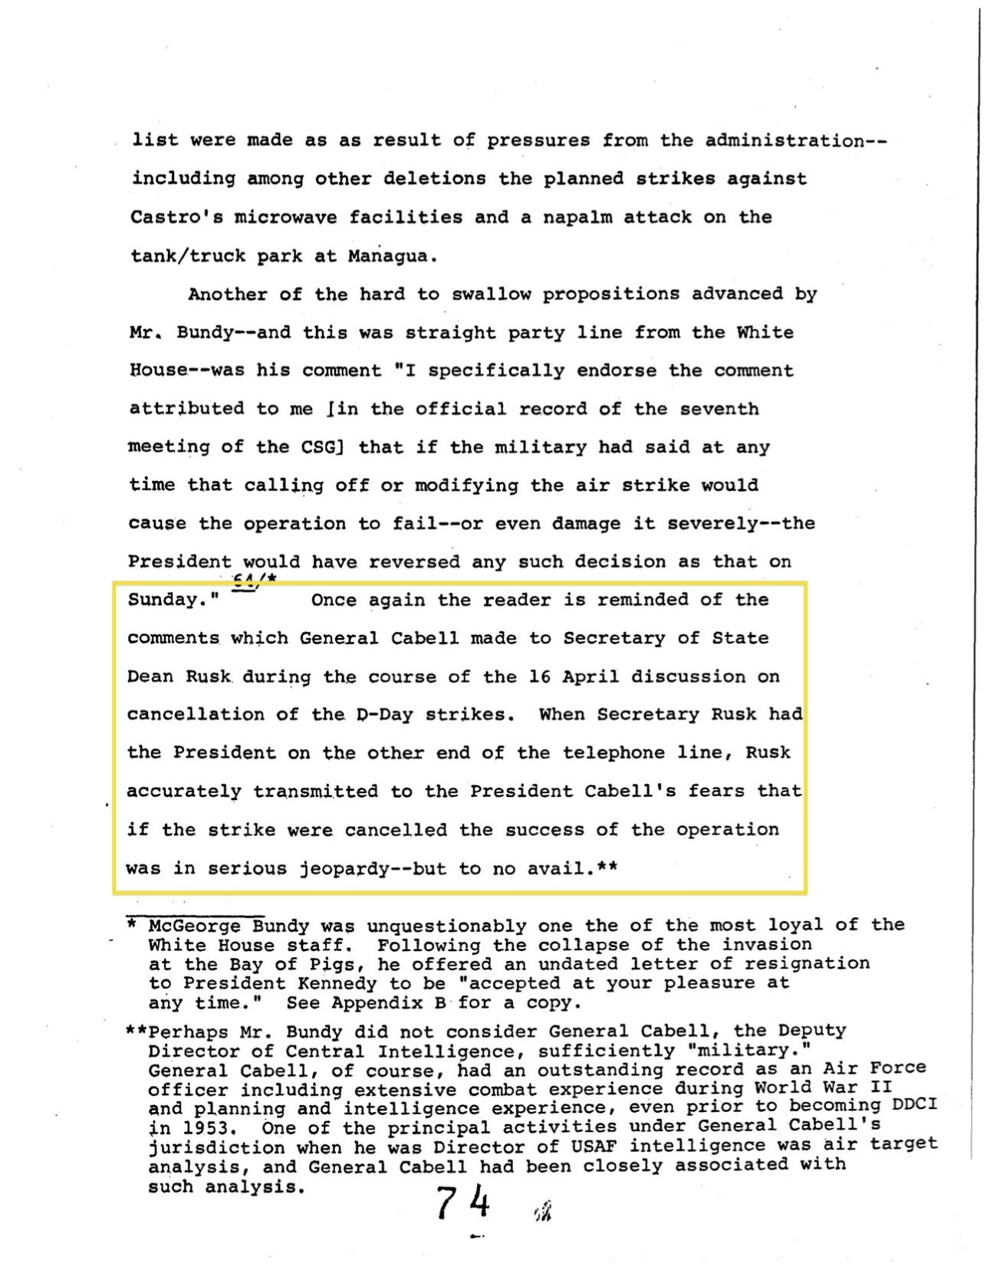

Slide 19
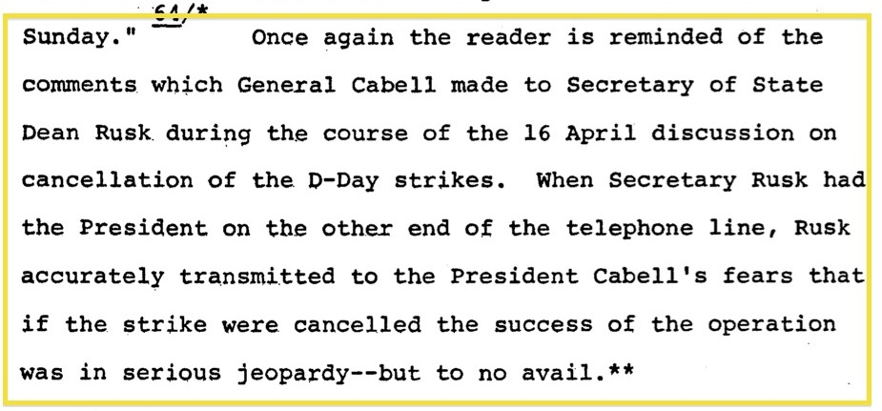
General Cabell
Dean Rusk

Slide 20
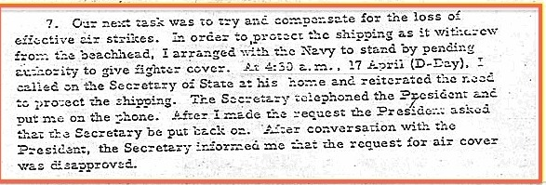

Slide 21
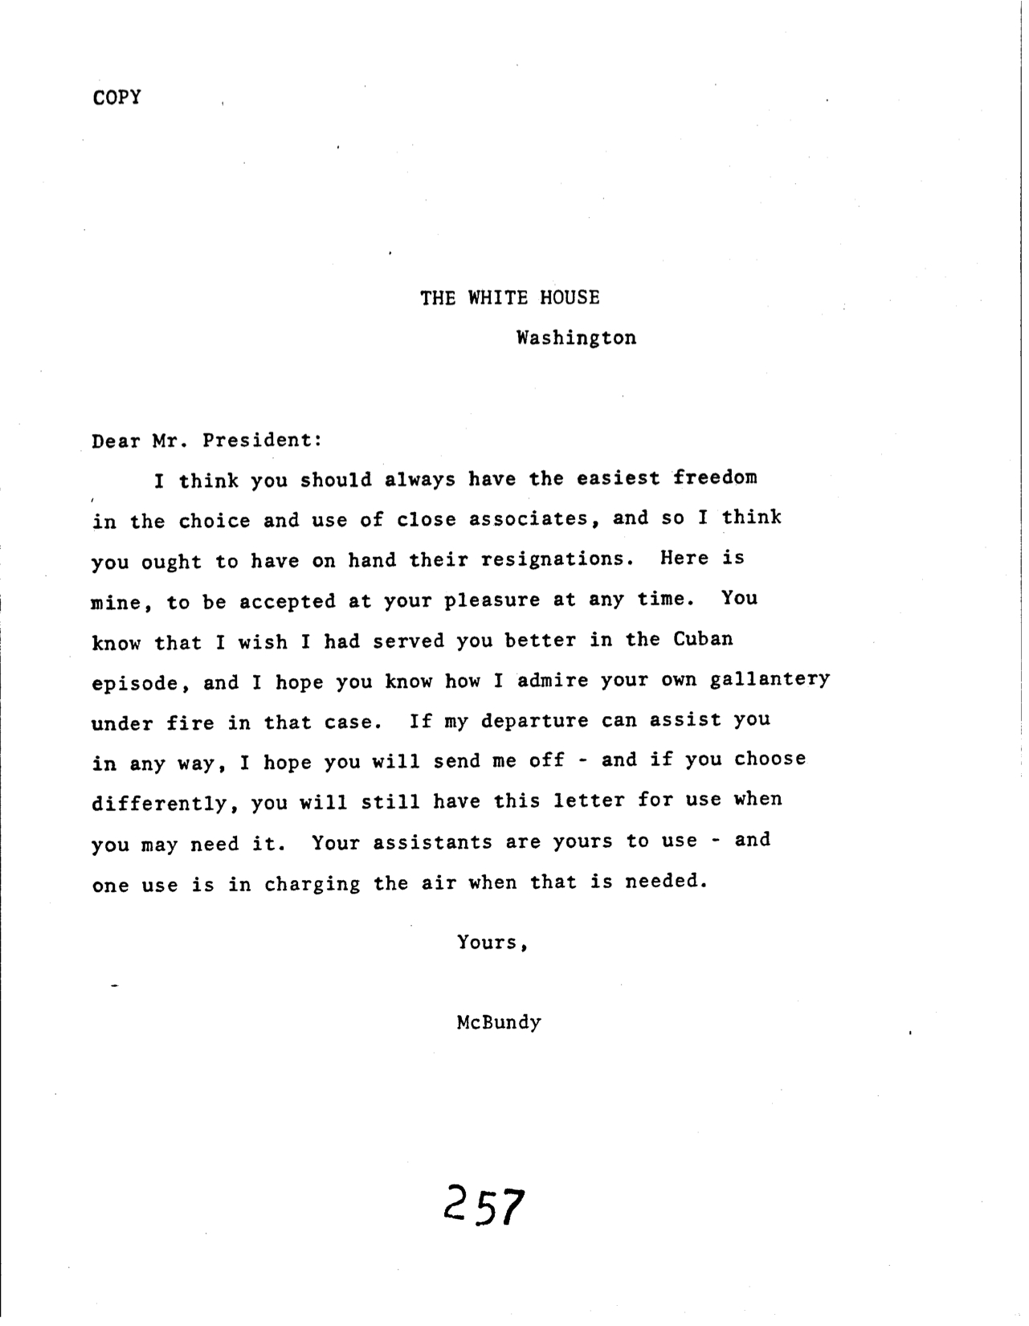

Slide 22
General Maxwell Taylor
Notes:
From a previously classified report by CIA’s Historical Staff Director, Dr. Pfieffer, in which he quotes General Maxwell Taylor, which confirms that the “issue” was never brought to the President in a timely fashion.

Slide 23
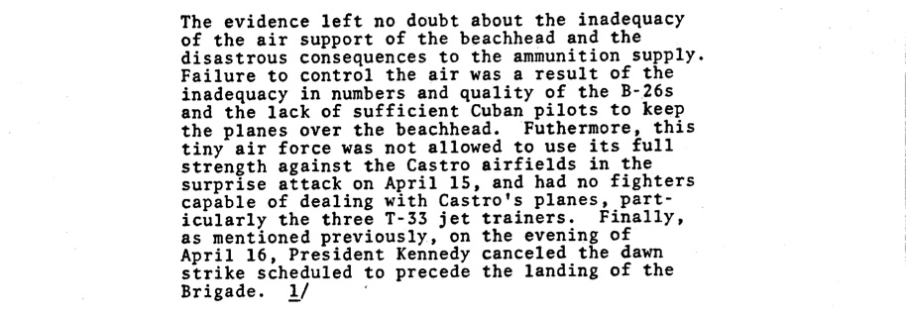
SWORDS AND PLOWSHARES By General Maxwell Taylor
1972
Notes:
Passage from General Maxwell Taylor’s 1972 book: Swords and Plowshares in which he incorrectly attributes the cancellation of the D-Day dawn airstrikes to Kennedy.

